Slide 1
Acute and Chronic Bronchitis
Dr. Harisankar V

Slide 2
Acute Bronchitis
This is acute inflammation of the bronchi and its ramifications.
characterized by cough,
discomfort behind the sternum,
scanty expectoration to start with,
later developing productive cough.
the infective agents are viral to start with, later bacteriae such as pneumococcus or H. influenzae may complicate.
At this time the sputum becomes purulent.
In patients with underlying disease such as chronic bronchitis and emphysema, and in heavy smokers bacterial superinfection is the rule.
Physical examination of the chest reveals wheeze and at times scattered crepitations.

Slide 3
Chronic Bronchitis
Chronic bronchitis is defined as a disease characterized by hypersecretion of mucus sufficient to cause cough and sputum on most days for at least three months in a year for two or more consecutive years.
This happens in the absence of any other specific respiratory or cardiovascular disease.
In the initial stages the inflammation of the bronchi is intermittent and recurrent, later it becomes established.
The larger air passages are affected during the early part of the disease, later obstructive features set in when the smaller airways are also affected.
Infection leads to periodic aggravation of the symptoms and the sputum, which is mucoid, becomes purulent during these episodes.

Slide 4
As the airways obstruction progresses, emphysema sets in.
These two processes become established in the majority of cases so that the condition is termed chronic bronchitis emphysema syndrome (CBES).
The disease is more common in damp, cold, and dusty regions.
Chronic Obstructive Pulmonary Disease (COPD) is a major cause of chronic morbidity and mortality throughout the world.
Chronic Obstructive Pulmonary Disease (COPD) is a disease state characterized by airflow limitation that is not fully reversible.
The airflow limitation is usually both progressive and associated with an abnormal inflammatory response of the lungs to noxious particles or gases. The most important risk factor for COPD is cigarette smoking.
Pipe, cigar and other types of tobacco smoking popular in many countries are also risk factors for COPD.

Slide 5
Passive exposure to cigarette smoke also contributes to respiratory symptoms and COPD.
Occupational dusts and chemicals (vapours, irritants, and fumes) when the exposures are sufficiently intense or prolonged.
Symptoms of COPD include:
Cough
Sputum production
Dyspnea on exertion
Episodes of acute worsening of these symptoms often occur.
Chronic cough and sputum production often precede the development of airflow limitation by many years, although not all individuals with cough and sputum production go on to develop COPD.

Slide 6
The inflammatory process in COPD differs from that in asthma in several ways.
The type of inflammatory cells, inflammatory mediators, final outcome and response to treatment are different.
In COPD the inflammation affects the peripheral airways-the bronchioles.
The cells are macrophages, CD8 lymphocytes and neutrophils.
The lung parenchyma is affected.
Pathology:
The bronchial mucosa shows hypertrophy and increase of the mucous glands and goblet cells with consequent overproduction of viscid mucus.
The distal airways show narrowing of lumen caused by increased height of the epithelium and increased thickness of the muscle and connective tissue.

Slide 7
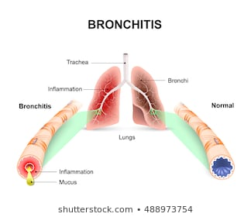
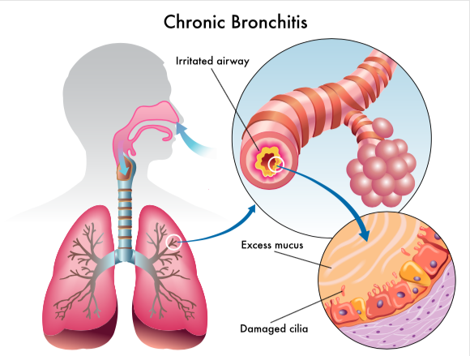

Slide 8
The mucosa becomes ulcerated and when the ulcers heal, fibrosis occurs resulting in distortion of the lumen with stenosis and dilatation.
Distortion of the airways leads to permanent obstruction.
Secondary infection occurs in the later stages.
The ciliary movement is further impaired by the abnormally viscid mucus. This aggravates infection and a vicious cycle is established.
Severe recurrent infections cause the development of microabscesses in the bronchial wall.
These heal with fibrosis.
Squamous metaplasia occurs.
Distortion and obstruction of the bronchial lumen result in air trapping and emphysema of the alveoli, some show collapse and
fibrosis.

Slide 9
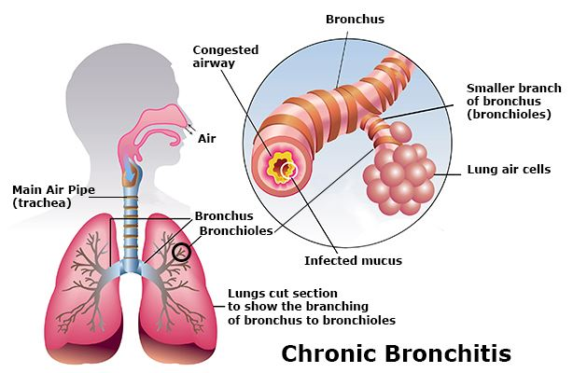
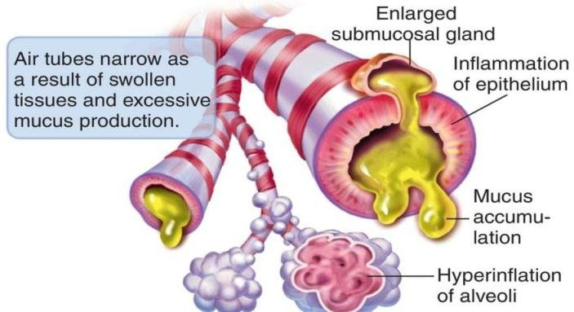

Slide 10
Summarized Pathological Process:
1. Inflammation of the bronchi with enlargement of mucous glands and smooth muscle hyperplasia, all leading to wall thickening
2. Acinar distension due to the destruction of lung parenchyma probably mediated by imbalance of protease-antiprotease (alpha-1 antitrypsin) enzymes causing loss of support of small airways
3. Fibrosis and narrowing of the airways leading to increase in airway resistance.
The capillary bed is distorted and truncated and this aggravates the progression of pulmonary arterial hypertension.
The pulmonary arteries become distended and atheromatous.
Pulmonary hypertension gives rise to right ventricular hypertrophy and dilatation.

Slide 11
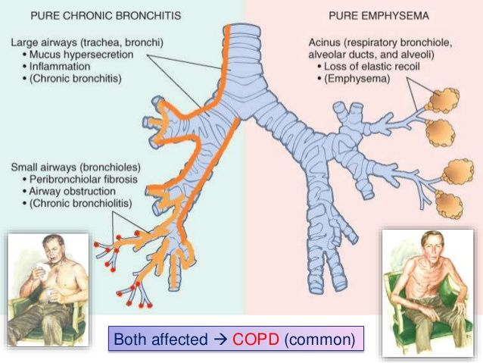

Slide 12
CLINICAL FEATURES
The clinical picture is varied depending on the severity and duration.
The most frequent early symptom is cough recurring year after year, especially so in winter months.
Later the cough becomes constant.
Expectoration is mucoid and the sputum is tenacious, especially on waking up in the morning.
Main complaint is the feeling of tightness of the chest.
Physical examination reveals mild wheeze which disappears as the patient clears the bronchi by expectoration.
Variable degrees of bilateral rhonchi and coarse crepitations are heard as adventitious sounds.
Initially acute infections give rise to fever and purulent sputum.

Slide 13
As the infection becomes established, fever and other general symptoms come down.
At this stage the quantity and character of the sputum are more reliable indicators of infection.
The sputum becomes copious in amount when bronchiectatic changes develop.
With the development of emphysema the chest assumes the inspiratory position and the respiratory excursions are considerably diminished.
At this stage dyspnea is far out of proportion to the physical findings in the chest.

Slide 14
Key Indicators for Considering the Diagnosis of COPD
Chronic cough: Present intermittently or every day. Often present throughout the day; seldom only nocturnal.
Chronic sputum production: Any pattern of chronic sputum production may indicate COPD
Acute bronchitis: Repeated episodes
Dyspnea that is: Progressive (worsens over time)
Persistent (present every day)
Worse on exercise
Worse during respiratory infections
History of exposure to risk factors: Tobacco smoke (including popular local preparations) Occupational dusts and chemicals and smoke from home cooking and heating fuel.

Slide 15
DIAGNOSIS
Chronic bronchitis should be diagnosed from the history of recurrent cough extending over several years, mucopurulent sputum and the physical findings of bronchial obstruction and emphysema. X-ray is normal in the early stages but the features of emphysema may be evident later.
HRCT is useful in quantifying the severity of emphysematous changes and locating areas with bronchiectatic changes.
Lung function tests show reduction in vital capacity, increase in the closing volume and features of airway obstruction .
Based on the spirometry values severity of obstruction can be categorised as mild, moderate severe and very severe.

Slide 16
Differential diagnosis:
Chronic bronchitis has to be distinguished from asthma. Differentiation is easy in the early stages but there is considerable overlap of symptoms and signs in the advanced stages, and, therefore, the clinical assessment is difficult.
Other conditions
Pulmonary Tuberculosis,
Bronchiectasis,
Heart Failure
Bronchogenic Carcinoma,
Obliterative Bronchiolitis.

